Slide 1
Front End Engineering
Project - 1
Team Details:
Gaurav Luthra (2210990317)
Gaurav Kumain (2210990319)
Gopal Krishna Shrivastava (2210990327)
Faculty Coordinator:
Parul Gehelot
Chitkara University Institute of Engineering and Technology,
Chitkara University, Punjab

Slide 2
Contents
Introduction
Problem Statement
Technical Details
Key Features
Project Highlights
Conclusion
References/Links used

Slide 3
Introduction
Ecommerce Website
GFactory
Gaurav Luthra (2210990317)
Gaurav Kumain (2210990319)
Gopal Shrivastava (2210990327)
Made By:

Slide 4
Problem Statement
"Designing and implementing an effective e-commerce website that maximizes user engagement, ensures a seamless shopping experience, and drives conversions, while overcoming challenges such as competition, technological advancements, and changing consumer preferences.?”

Slide 5





Technical Details
We employed HTML, CSS, Bootstrap for crafting the user interface, and React Js to create interactive ui.
Our choice of editor was Visual Studio Code, and we utilized Git and GitHub for collaborative work.
Netlify served as our hosting platform.

Slide 6
Key Features
User-friendly Interface: An intuitive and easy-to-navigate interface that allows users to browse products, view details, and make purchases effortlessly.
Product Catalog: A well-organized catalog showcasing products with detailed descriptions, images, pricing, and specifications.
3. Shopping Cart: A virtual shopping cart that allows users to add, remove, and manage items before checkout.

Slide 7
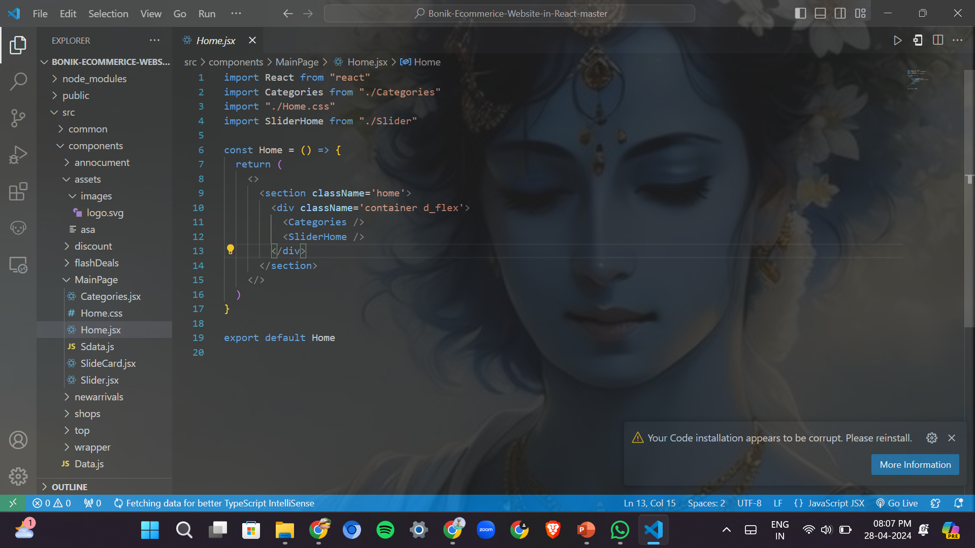
Project Highlights 1
JSX CODE SNIPPETS:

Slide 8
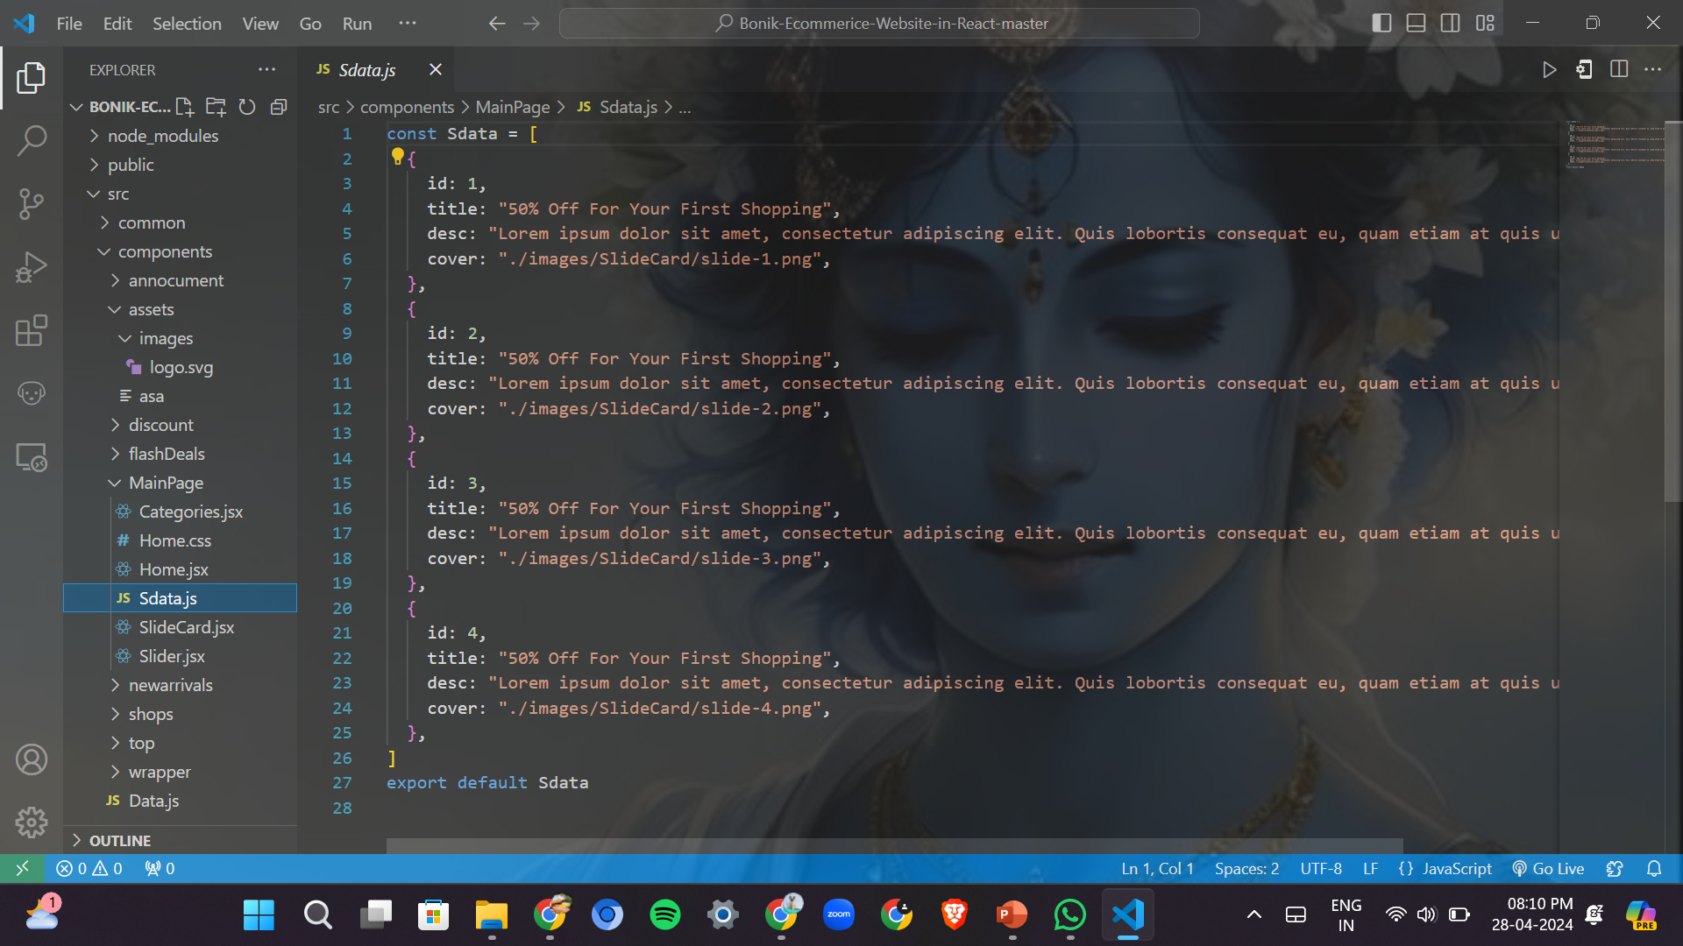
Project Highlights 1

Slide 9
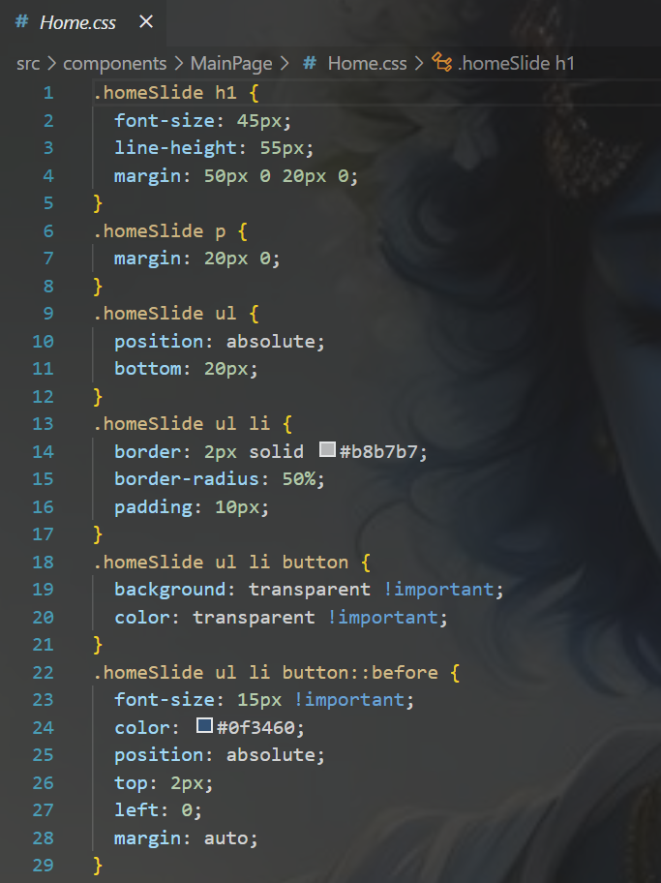
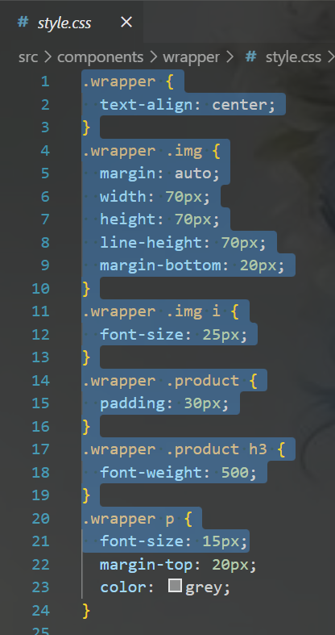
Project Highlights 2
CSS CODE SNIPPETS:

Slide 10
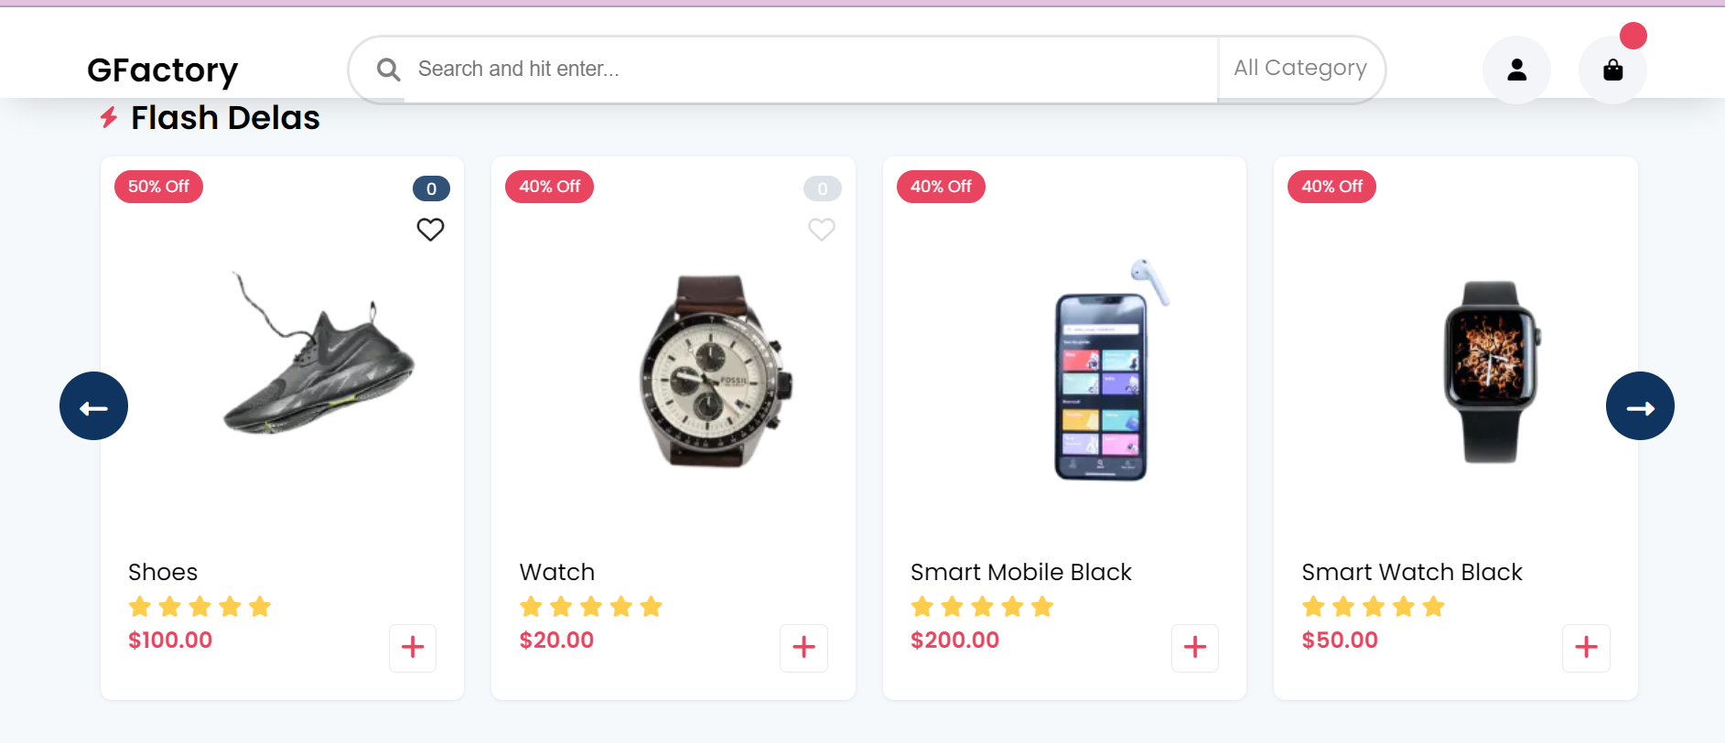
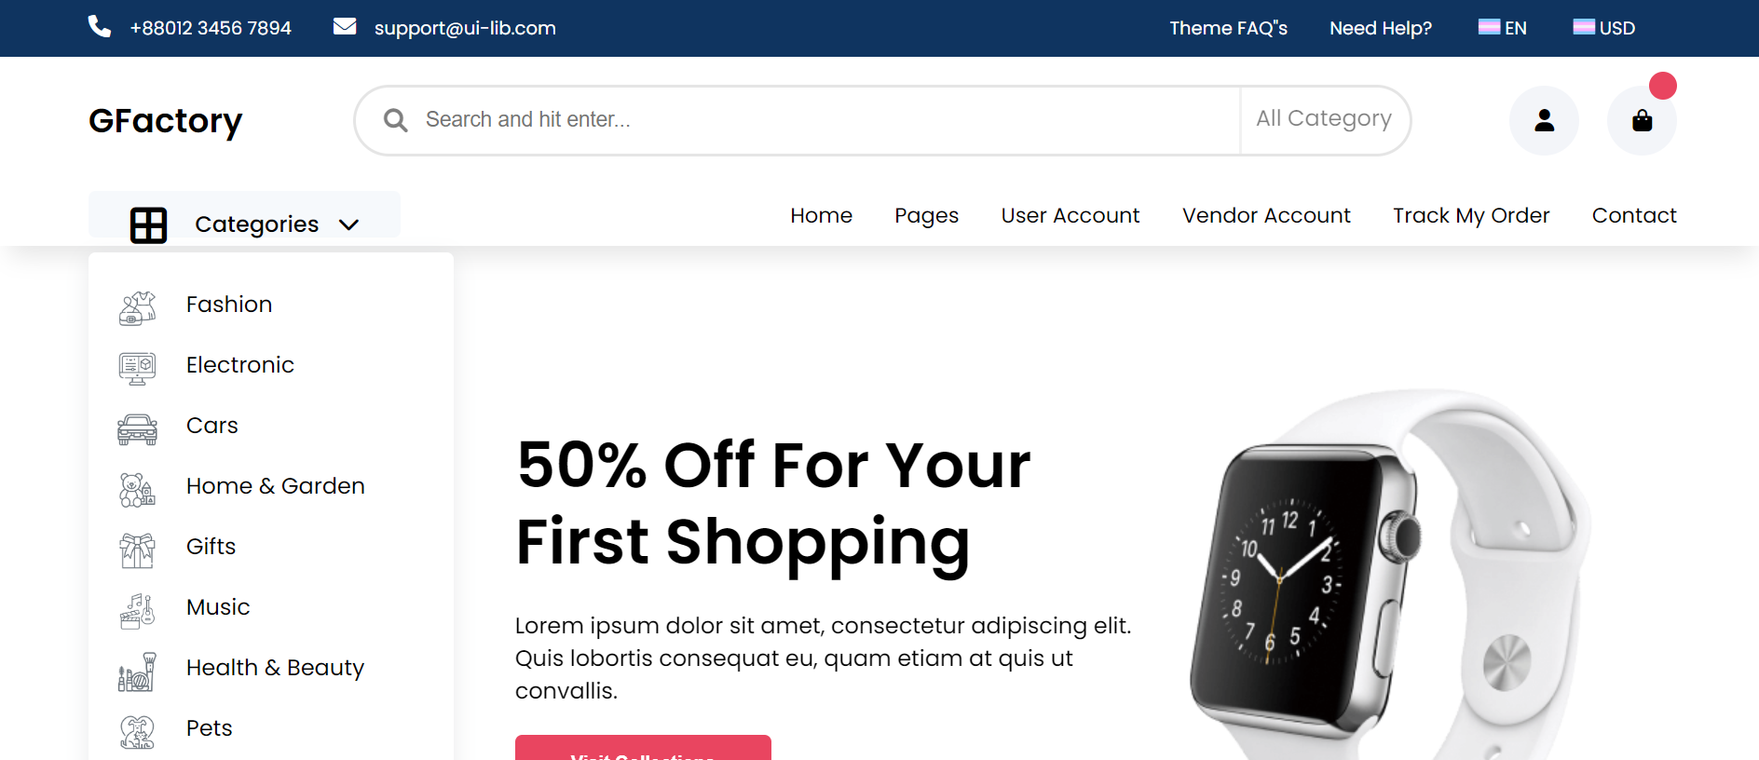
A Look at Our Online Store
.

Slide 11
Conclusion
In conclusion, our e-commerce website is designed to provide users with a seamless and enjoyable shopping experience.
With a user-friendly interface, intuitive navigation, and responsive design, we aim to make online shopping easy and convenient for our customers.
Our website showcases products effectively, with detailed descriptions and high-quality images, ensuring that customers can make informed purchase decisions.
We are committed to continuously improving our website based on user feedback and implementing new features to enhance the overall shopping experience.
Thank you for taking the time to learn about our website, and we look forward to serving you as you explore our online store

Slide 12
References/Links used
WIKIPEDIA- https://www.wikipedia.org/
W3SCHOOLS-https://www.w3schools.com/
Myntra:https://www.myntra.com/
Amazon:https://www.amazon.com/

Slide 13
Thank You

